Slide 1
Having the Deprescribing Discussion: Empowering yourself and your patients to optimize medications
Sydney Springer, Pharm.D., M.S., BCPS, BCGP

Slide 2
Objectives
Those who are actively engaged in this webinar should be able to:
Identify common barriers to initiating the “Deprescribing Conversation”
Apply the FRAME approach to initiating conversations around deprescribing and medication appropriateness
Utilize internet-based and Application-based resources to guide deprescribing efforts

Slide 3
What is Deprescribing?
“The systematic process of identifying and discontinuing drugs in instances in which existing or potential harms outweigh existing or potential benefits within the context of an individual patient’s care goals, current level of functioning, life expectancy, values, and preferences.”
Scott IA, et al. JAMA Intern Med. 2015

Slide 4
Why is this so hard as a Provider?
Lack of time
Ineffective communication across the healthcare system
Lack of effective language
Lack of knowledge, clinical guidance or training
Fear of patient perception of “giving up” or “withdrawal of care”
Peat G, et al. BMJ Open. 2022; 12(3):e054279.
Notes:
Source to cite: https://www.ncbi.nlm.nih.gov/pmc/articles/PMC8961139/

Slide 5
Consumer attitudes
Upwards of 80-85% of adults and caregivers agree that they would be willing to stop one or more of their medications if their provider said it was possible.
However, 67-93% of adults and caregivers agree that they are satisfied with their current medication regimen
Weir KB, et al. J Gerontol A Biol Sci Med Sci. 2022 May 5; 77(5):1020-34
Notes:
https://pubmed.ncbi.nlm.nih.gov/34390339/

Slide 6
The “FRAME” Acronym for Deprescribing Conversations
F | Fortify Trust
R | Recognize patient’s willingness/barriers to deprescribing
A | Align deprescribing recommendations with goals of care
M | Manage Cognitive Dissonance
E | Empower patients/caregivers to continue the conversation
Felton M, et al. Communication Techniques for Deprescribing Conversations. Fast Facts and Concepts. Dec 2018; 369. Available at: https://www.mypcnow.org

Slide 7
1. Fortify Trust
“Callous deprescribing advice can lead to mistrust, feelings of abandonment, or a sense of futility of previous compliance.”
Felton M, et al
Building a foundation of trust and respect by listening more than talking, and validate concerns
Felton M, et al. Communication Techniques for Deprescribing Conversations. Fast Facts and Concepts. Dec 2018; 369. Available at: https://www.mypcnow.org

Slide 8
Trusting Language
“Thank you for taking time to talk to me today”
“It sounds like this has been really frustrating”
“You are doing so much to help with the care of your mother”
Collier KS, et al. Home Healthc Nurse. 2013 Oct;31(9):518-24.

Slide 9
2. Recognize Willingness and Barriers
Psychological connection to meds vs. burden of polypharmacy
Most then 90% of older adults are willing to stop their medications if they are told by their provider this is safe
Use validated surveys or open-ended questions
Felton M, et al. Communication Techniques for Deprescribing Conversations. Fast Facts and Concepts. Dec 2018; 369. Available at: https://www.mypcnow.org
Reeve E, et al. Drugs Aging. 2016 Dec;33(12):913-928.

Slide 10
Perceived Barriers by Patients
Clinical Inertia:
“I feel well now, obviously all of my drugs are needed”
”I’d generally love to stop medication! But I need the painkiller and proton pump inhibitor.”
Fragmented care:
“Each and every doctor takes care of their medications – almost one specialist for every drug.”
Acceptance of Burden:
“First I didn’t like the fact, but now I accepted that I need them.”
Zechmann S, et al. BMC Fam Pract. 2019 May 14; 20(1):64.
Pollak KI. J Palliat Med. 2011 May; 14(5):587-92.
Collier KS, et al. Home Healthcare Nurse. Oct 2013; 31(9_:518-24.

Slide 11
Additional Perceived Barriers
Lack of trust
Confusion about their goals of care and treatment targets
Difficulty assessing benefit of one medication amongst many
Fear of stopping
Lack of time or monitoring available
Perception that provider would stop medication if they felt it was necessary
Crutzen S, et al. Front Pharmacol. 2020 Aug 20;11:1268.

Slide 12
Perceived Enablers by Patients
Fear or perceived negative belief about medications
Medication burden
Prior side effects
Patient is feeling well
Prior positive experience stopping medication(s)
Provider brings up stopping the medication
Proper follow-up and monitoring upon discontinuation planned
Crutzen S, et al. Front Pharmacol. 2020 Aug 20;11:1268.

Slide 13
Break “Barriers” and Support “Enablers” with the Proper Resources

Slide 14
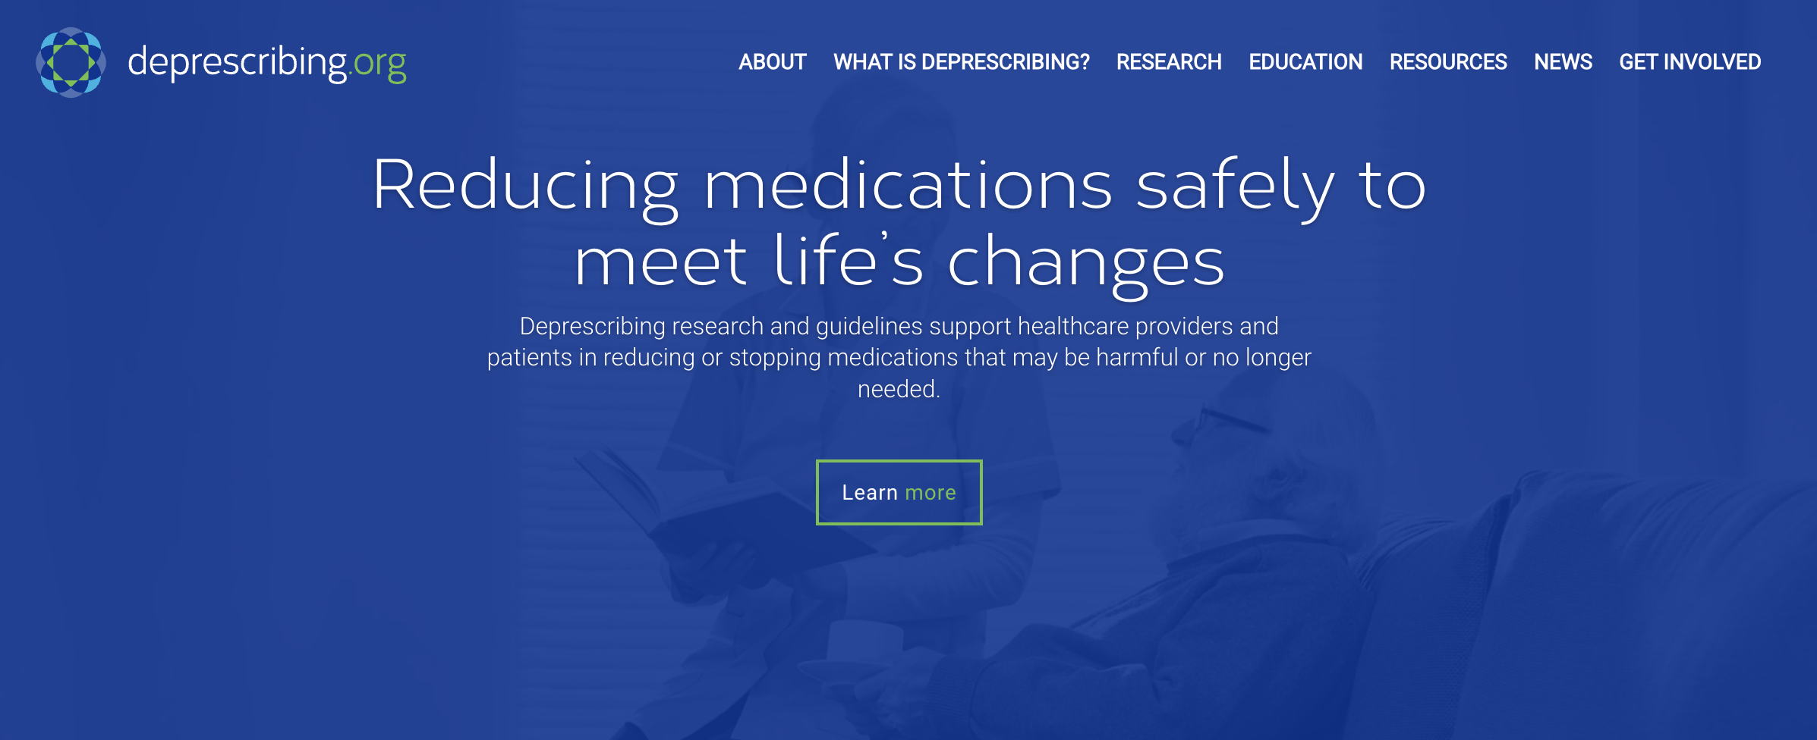
Deprescribing.Org

Slide 15
Clinical Deprescribing Algorithms

Slide 16

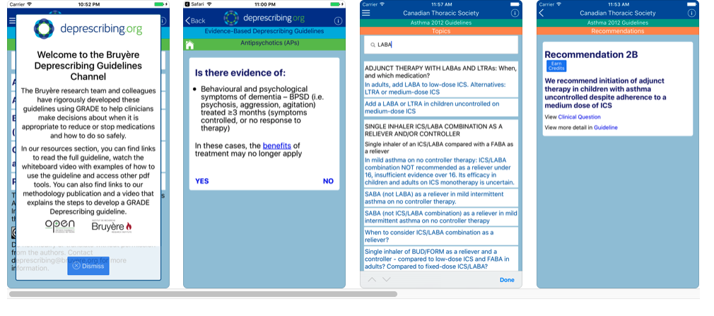
There is an App for that!

Slide 17


Slide 18
What it offers:
Investigator development
Grant opportunities for researchers
Resources for clinicians
Research help/literature search review help
Repository of literature on deprescribing
Webinars
Working groups

Slide 19


Primary Health Tasmania and New South Wales

Slide 20
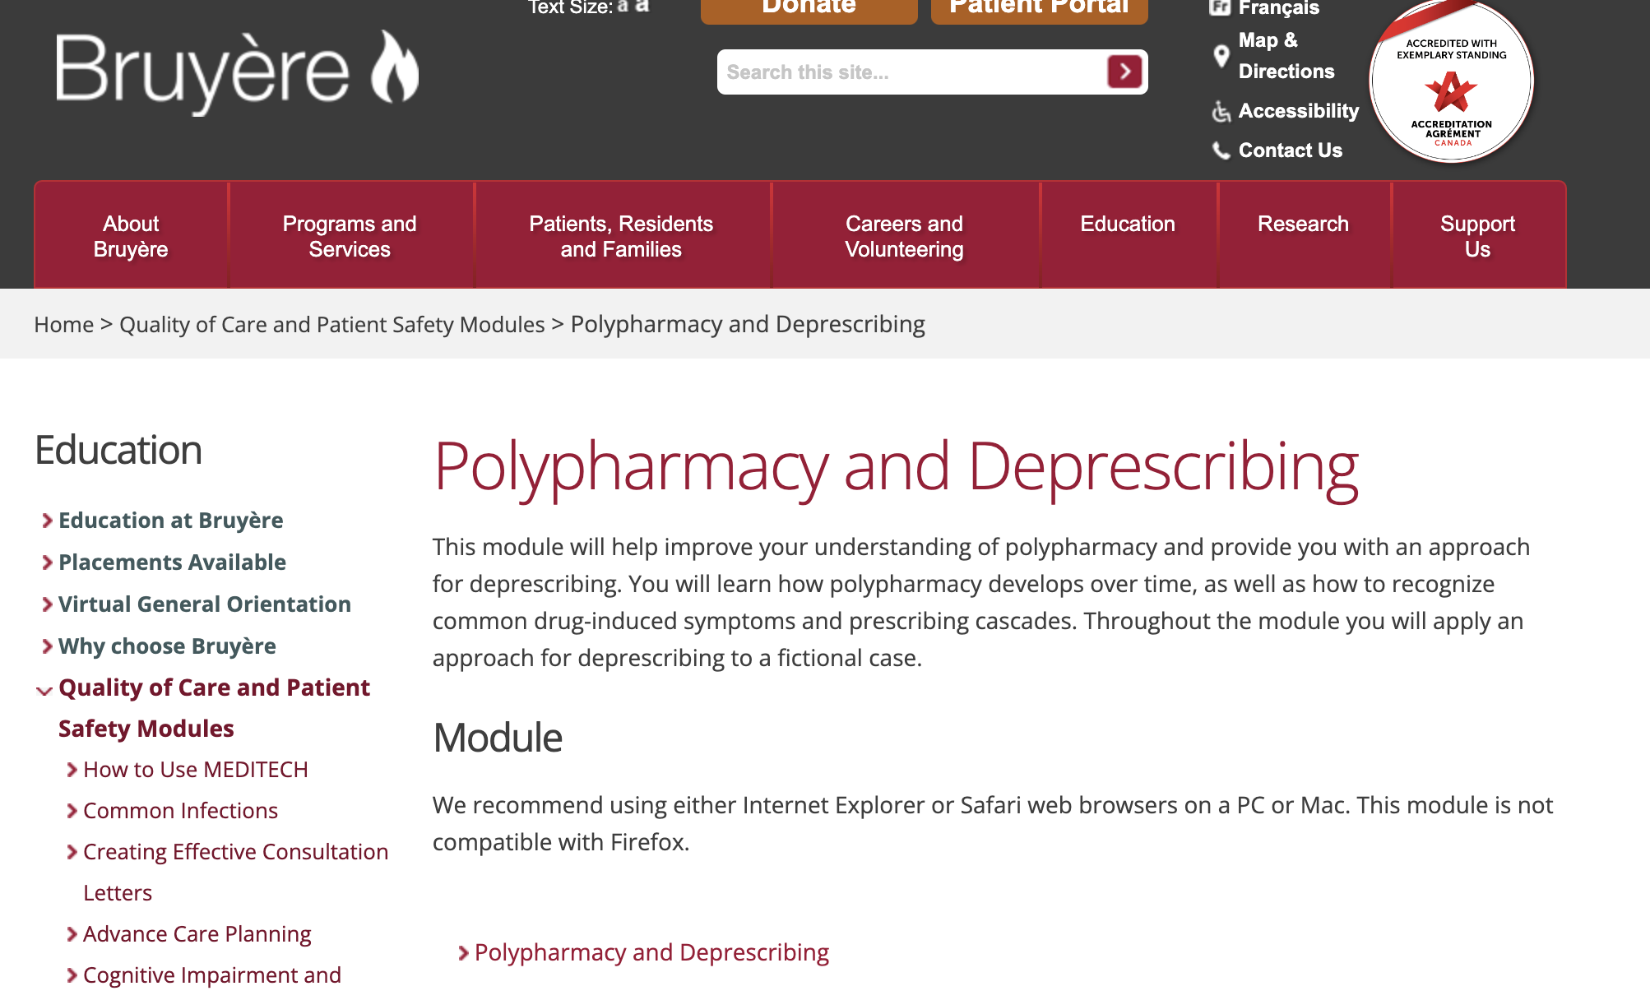
Bruyère Polypharmacy Module

Slide 21
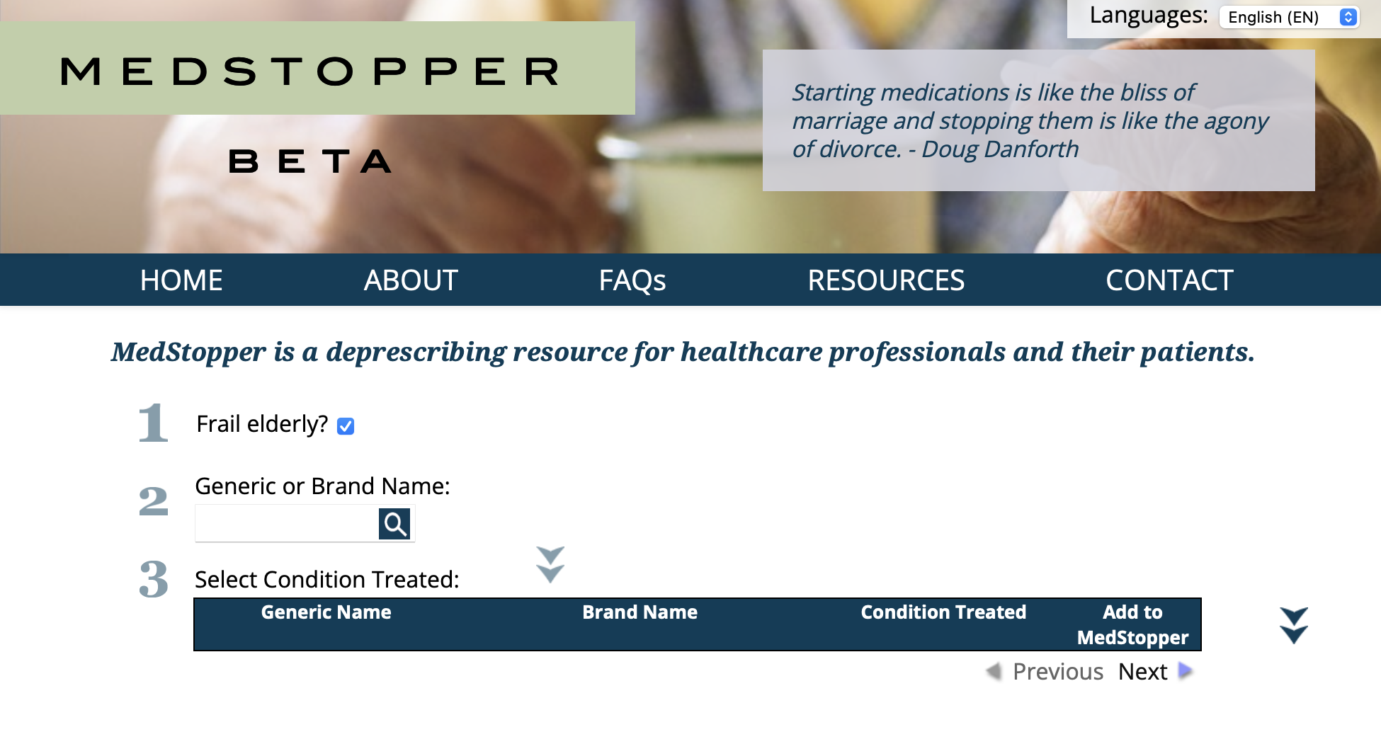
MedStopper

Slide 22
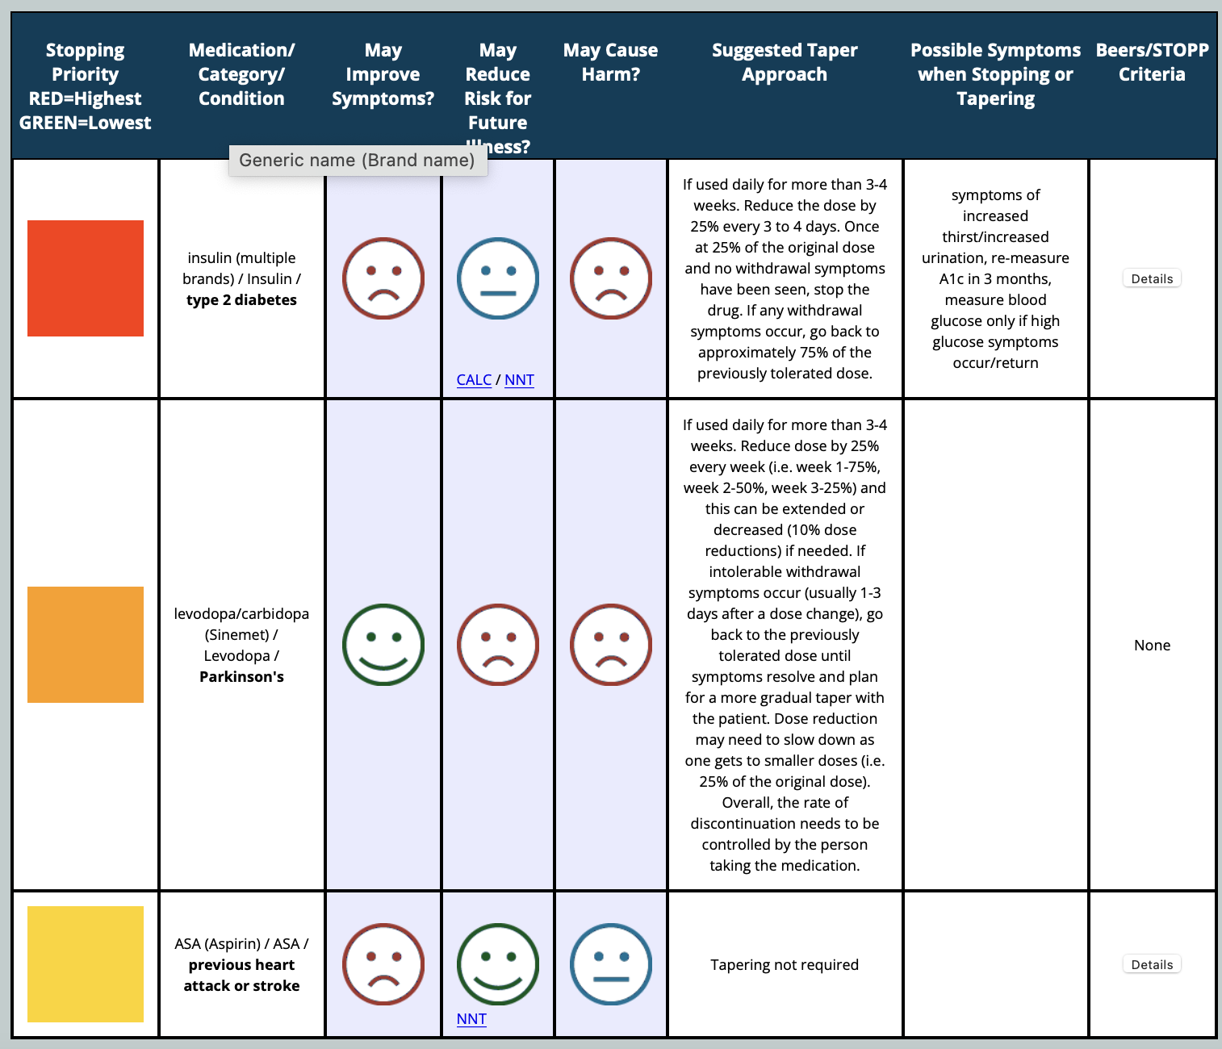
MedStopper

Slide 23
Assessing and Exploring “Willingness” To Deprescribe
Revised Patient Attitudes Towards Deprescribing Questionnaire
22 items, can be done by patient or caregiver
Assesses: medication burden, involvement in their care, appropriateness of medication (perceived), concerns about stopping medications
2 global questions about willingness to discontinue medications and medication satisfaction
Reeve E, et al. Drugs Aging. 2016 Dec;33(12):913-928.

Slide 24
So, you don’t want to give you patients a 22-item survey!?
Just ask them a couple questions:
“Do you feel like you are taking too many medications?”
“Do you feel like your medications are inconvenient to take, which ones?”
“Do you feel like one or more of your medications is causing harm or is no longer needed? Which ones?”
“If we stopped one of your medications, would you be worried about side effects or loss of long-term benefit?”
Reeve E, et al. Drugs Aging. 2016 Dec;33(12):913-928.

Slide 25
Using Motivational Interviewing: RULE
Resist… | the righting reflex
Understand… | the patient’s motivation – assess patient’s stage of willingness to pursue deprescribing
Listen… | to the patient with empathy
Empower… | through education and noticing even small changes
Felton M, et al. Communication Techniques for Deprescribing Conversations. Fast Facts and Concepts. Dec 2018; 369. Available at: https://www.mypcnow.org
Pollak KI, et al. J Palliat Med. 2011 May; 14(5):587-92.
Notes:
The 3 tenents of MI are” collaboration, autonomy, and evocation. We touched upon collaboration and autonomy when we discussed fortifying trust.
The third tenant of motivation interview is: ”Evocation. The third tenet leads clinicians to elicit information from patients about internal motivations and help them reflect on the advantages of and barriers to change. Patients are more likely to change when they, rather than health care providers, express their values, goals, and ideas for change. Clinicians, in turn, strive to elicit patients' own internal motivations to make their own decisions rather than educating or warning them about what they should or should not do.”

Slide 26
3. Align Goals
Quality or Quantity of Life?
“Thank you for telling me that you want to spend more time gardening. I want to discontinue your metoprolol as this medication can cause fatigue as your heart rate has been low lately.”
Felton M, et al. Communication Techniques for Deprescribing Conversations. Fast Facts and Concepts. Dec 2018; 369. Available at: https://www.mypcnow.org
Notes:
You can assess someone’s interest in quality or quantity of life. This may be more relevant to patients who are near end of life, or have been faced with a life limiting illness. This may not be the case for your community dwelling older adult patients. Instead, asked about what makes them happy, what motivates them on a daily basis. Are medications at all hindering this?

Slide 27
Misaligned Goals:
Goal | Misalignment
Seeing friends on a regular basis | Diuretics given more than once daily or later in the day
Maintaining cognitive wellbeing | Benzodiazepines or anticholinergics used for insomnia
Going to the beach in the summer | Use of chronic medications with phototoxic side effects
Reduced hypoglycemia episodes | Continuing sulfonylureas or short-acting insulin in patients with type 2 diabetes
Reduced risk of falling | Continuation of anticholinergics, benzodiazepines, 3 or more CNS-acting medications, diuretics used for hypertension, proton pump inhibitors, NSAIDs, and more!

Slide 28
4. Manage Cognitive Dissonance
Two or more contradictory thoughts, ideals, beliefs or values that cause mental discomfort
What a patient believes is helping them may actually be harming them
Options:
  Being direct
  Offering an emotional response
  Education and reading resources
Felton M, et al. Communication Techniques for Deprescribing Conversations. Fast Facts and Concepts. Dec 2018; 369. Available at: https://www.mypcnow.org
Notes:
Direct: “I know you are taking a lot of medications, but I don’t think it’s good for you to be on this many. I want to reduce this to a more manageable number of medications for you.”
Emotional: “I am worried about your falls. Some of your medications may be hurting not helping you by clouding your mind and affecting your concentration and balance.”
Reading for Next Time: A randomized study of 303 long-term users of benzodiazepines (BZDs) showed that an interventional group who received a “Reading for Next Time” deprescribing brochure that described the risks of BZD use was significantly more likely to discontinue BZDs (number needed to treat, 4) than a control group (15). In its simplest form, “Reading for Next Time” is stating, “Here is some information regarding [medication X]. Read this prior to our next visit and we can discuss”. Brochures are available for many medication classes via the Canadian Deprescribing Network (16).

Slide 29
5. Empower to Continue the Conversation
Let them know you are willing to continue the conversation
Use motivational interviewing to explore interest in future conversation
Set up the conversation with other healthcare providers
  Connect with the cardiologist about stopping their metoprolol
  Connect with the psychiatrist about the long-term risk of benzodiazepines
  Connect with the gastroenterologist about safety and appropriateness of long-term proton pump inhibitors in your patient
Encourage your patient to have these conversations with the prescribing providers
Felton M, et al. Communication Techniques for Deprescribing Conversations. Fast Facts and Concepts. Dec 2018; 369. Available at: https://www.mypcnow.org

Slide 30
Deprescribing.org
Patient Pamphlets and Infographics

Slide 31
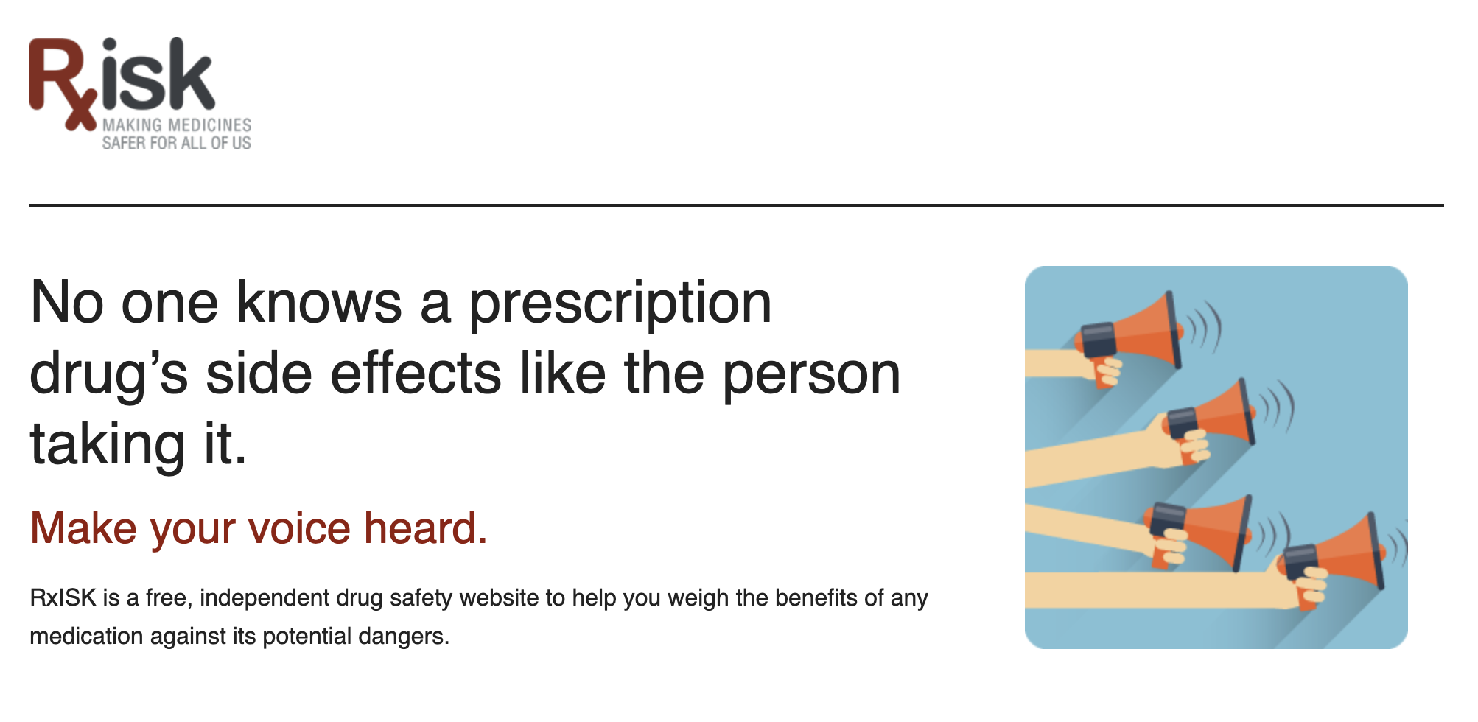
Rxisk.org

Slide 32

Mysleepwell.ca

Slide 33
Recap:
Consider the FRAME technique to initiation conversations around deprescribing
The “problem” may be misinterpretation of roles
Motivational interviewing is a great technique to assess goals and interest in deprescribing
In patients with a large number of medications, consider offering a medication-focused visit

Slide 34
Questions?
Sydney Springer, Pharm.D, M.S., BCPS, BCGP
Email: springers339@gmail.com

