Slide 1
Integrating the Age Friendly 4Ms into the Care of Older Adults
Mary Tinetti, MD
31st Maine Geriatrics Conference
May, 2024
Patientprioritiescare.org

Slide 2
Today I will…
Describe what the Age Friendly Health System initiative is and why it matters - particularly for persons with multiple chronic conditions (MCCs), care partners, & health professionals
Present the what, why, and how of the 4Ms
Discuss how the 4Ms work in practice
Suggest how to get started

Slide 3
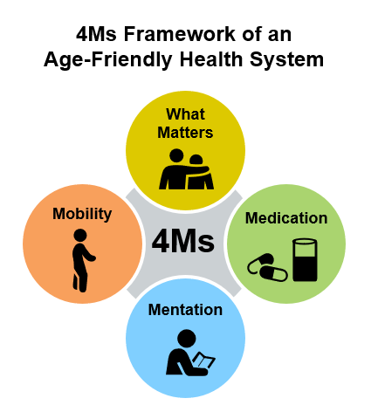
Age Friendly Health System Initiative
Aim: Ensure safe and appropriate care of older adults in all settings
Sponsored by John A. Hartford Foundation, Institute for Healthcare Improvement, American Hospital Association, Catholic Hospital Association
3000+ health systems, hospitals, practices, etc.
Notes:
Kedar

Slide 4
Trigger for AFHS: Evidence-Practice Gap
91.3%
Many evidence-based geriatric-care models of care have proven effective
Most evidence reaches small portion of those who could benefit
Close the evidence-practice gap
8.7%
IHI Analysis of Model Beneficiaries 2016
Met Need – 8.7% Unmet Need – 91.3%
Notes:
KellyAnne
Difficult to disseminate and scale
Difficult to reproduce in settings with less resources
May not translate across care settings

Slide 5
How did the 4Ms of AFHS evolve?
IHI convened health system leaders, MDs, nurses, patients, caregivers
Identified models serving older adults associated with improved quality of life, health care utilization, function
Over 90 components
3 core elements common to most models:
  - Cognition and mood (Mentation)
  - Function and mobility (Mobility)
    - Medication benefits & harms (Medication)
Patients’ goals & preferences (Matters most) added (core to patient centered care)
Notes:
Mary
150 articles 17 care models
What pop, what outcomes, and what core features…what were the active ingredients of the model
That improved care for older adults.

Slide 6
The 4Ms Framework of Age Friendly Care
Implement a set of evidence-based best practice interventions across four core elements to all older adults in all care settings.
The 4Ms | Description
What Matters | Know & align care with each older adult’s specific health outcome goals and care preferences (not limited to end-of-life)
Medication | If medication is necessary, use medications that support (do not interfere with) What Matters to the older adult, Mobility, or Mentation (physical or cognitive functioning)
Mentation | Prevent, identify, treat, and manage dementia, depression, delirium
Mobility | Ensure that older adults move safely every day to maintain function and do What Matters
Fulmer T, Mate KS, Berman A. The Age-Friendly Health System imperative. J Am Geriatr Soc. 2018; 66(1):22-24.
Notes:
Kedar

Slide 7
To illustrate why 4Ms, meet Mr. A. with fatigue, decreased appetite, weakness
82 years old
Retired teacher
Divorced but good relationship with ex-wife
Enough money to get by as
long as no unexpected expenses
Independent in his basic and
instrumental activities of daily living but doesn’t cook

Slide 8
To illustrate why 4Ms, Mr A, with fatigue, decreased appetite, weakness
Previous M.I. Diabetes Hypertension Heart failure (EF 28%) Osteoporosis Depression Arthritis | He thinks… his medications are causing a lot of his symptoms too much of his time involved in his health care

Slide 9

Current care for Mr. A
Cardiologist: Heart failure & blood pressure (↑ β-blocker; add SGLT-2 inhibitor)
Endocrinologist: DM (start insulin; add another oral agent)
Psychiatrist: Depression (↓ or stop β-blocker, add 2nd antidepressant; start counselling)
Primary Care: 15-20 minutes to address everything; has to meet BP & A1C quality metrics
Care coordinator: told to encourage adherence to medications he thinks causes his fatigue
Result for Mr. A: ~15 healthcare encounters/month; 12 medications (? adherence) → fatigue, weakness,↓ appetite; conflicting recommendations, more interventions to already time-consuming regimen

Slide 10

Care may be of uncertain benefit
>2/3 older adults have multiple chronic conditions, functional limitations, complex social needs
Few older adults with multiple conditions, functional limitations, social needs in RCTs
Older adults with multiple conditions may have less benefit from treatments than RCTs suggest
With multiple conditions: what outcome defines benefit??

Slide 11
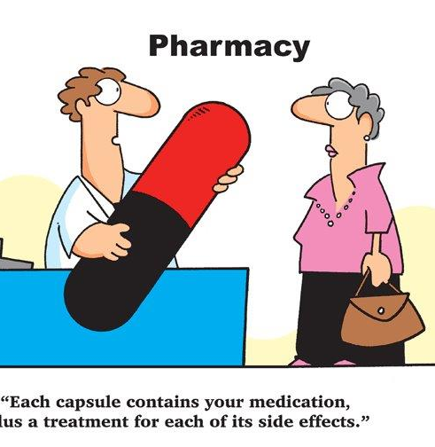
Unintentional harm of guideline recommended medications
1 in 3 (Lorgunpai, PLOS One, 2014)
10% ADE/drug
(Gandhi, NEJM, 2013)

Slide 12
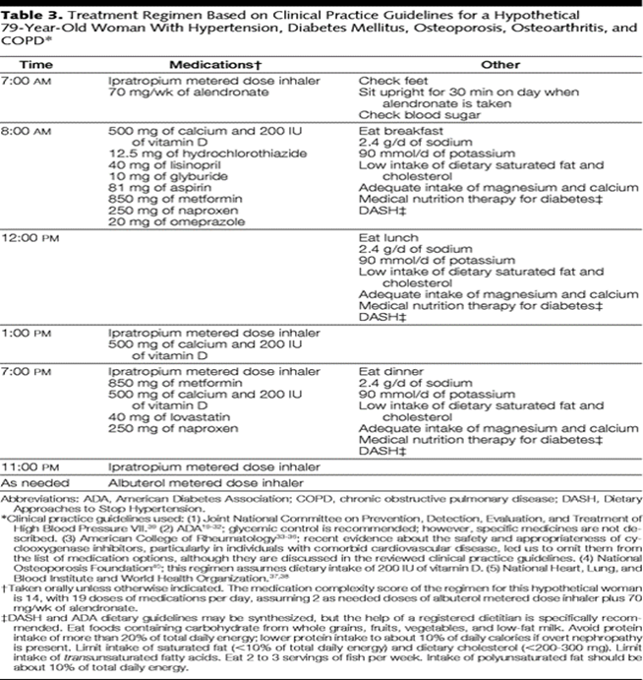
Managing chronic conditions often burdensome
2 hours per day self-management tasks
½ day per visit
Full day per procedures
“Caring for my chronic conditions is more burdensome than the conditions” (Montori; Boyd)

Slide 13

Care not always aligned with what matters most …
Older adults vary in outcome goals in face of tradeoffs
Fried TR, Arch Int Med, 2012

Slide 14

Challenges in healthcare for older adults
Uncertain benefits & harms
Fragmented, conflicting
Burdensome
May not focus on what matters most to the person

Slide 15
How 4Ms address these challenges
Represent:
  What matters to older adults
  Universal outcomes (across conditions)
Simplifies and focuses care (for patient & health professionals)
Provide common targets for all health professionals
Built on strong evidence base
Notes:
Mary

Slide 16
4Ms: Outcome goals of older adults (N=169)
Participate in activities with family or friends (24%)
Participate in exercise as physical activity (9%)
Go shopping (6%)
Paid or volunteer work (6%)
Participate in social or religious organizations (6%)
Take trips (5%)
Take care of family or friend (4%)
Artistic activities (4%)
Tinetti ME et al. Outcome Goals and Healthcare Preferences of Older Adults with Multiple Chronic Conditions. JAMA Netw Open. 2021;4(3):e211271

Slide 17
4Ms: Outcomes affected by chronic conditions (universal health outcomes)
Condition | Universal health outcome
 | Cognitive or physical function/ Mobility | Symptom burden | Survival
Arthritis | √√ | √√ | --
COPD | √ | √ | √√√
Dementia | √√ | -- | √√
Depression | √√ | √√√ | √
Heart failure | √√√ | √√ | √√√
Tinetti et al. J Am Geriatr Soc, 2011

Slide 18
How 4Ms address challenges in care of older adults
Represent:
  what matters to older adults
  Universal outcomes (across conditions)
Simplifies and focuses care (for patient & health professionals)
Provide common targets for all health professionals
Built on strong evidence base
Notes:
Mary

Slide 19
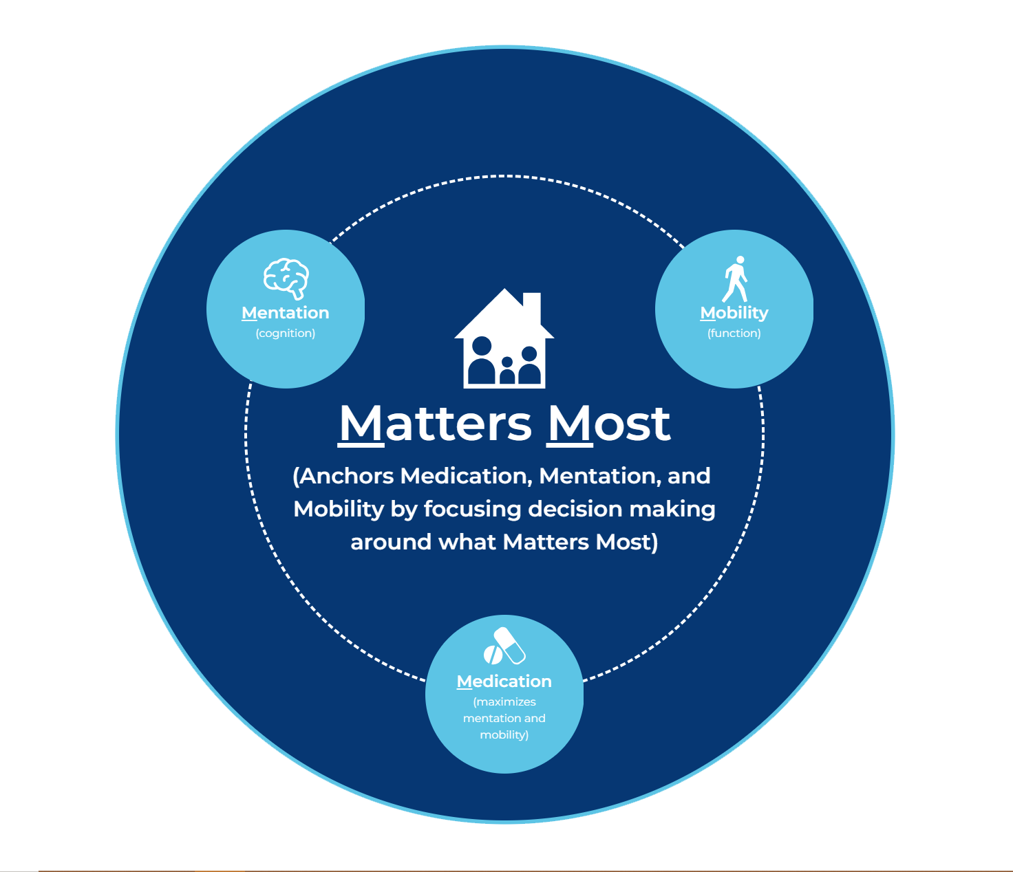
Interrelationships among the 4Ms: Simplifies & focuses care

Slide 20
How 4Ms address challenges in care of older adults
Represent
  what matters to older adults & universal outcomes (across conditions)
Simplifies and focuses care (for patient & health professionals)
Provide common targets for all health professionals
Built on strong evidence base
Notes:
Mary

Slide 21
4Ms: Common target for all health professionals
PT/OT
Nurse
Dietitian
SW
medications, mentation,
mobility
What Matters
PCP
Pharmacist
Care
Coordinator
specialist

Slide 22
How 4Ms address challenges in care of older adults
Represent:
  what matters to older adults
  Universal outcomes (across conditions)
Simplifies and focuses care (for patient & health professionals)
Provide common targets for all health professionals
Built on strong evidence base
Notes:
Mary

Slide 23
Evidence supporting asking and acting on What Matters to older adults
Better patient experiences score & retention
Avoid unnecessary utilization
  ↓ ICU stays 80%
  ↑ hospice use 47%
Older adults vary in priority in face of tradeoffs ~40% function; 30% symptoms, 30% live longer (Fried)

Slide 24


Evidence supporting asking & acting on What Matters to Older adults
Less Unwanted Care
Medications stopped (↑2-3X)
Tests (↓30%)
Self management tasks (↓30%)
More Wanted Care
Wanted self management tasks
More rehabilitation & supportive services
Tinetti, et al. JAMAInt Med, 2019; Freytag,et al, J Am Geriatr Soc, 2020

Slide 25
Evidence supporting asking & acting on What Matters to older adults: Clinicians
“It did help to focus the conversation better. Normally, we just go over the list of problems they've had and try and work through each one in isolation.”
“I think that the individual goals I like. […] kind of gives us something to shoot for—and it’s a way for us to kind of motivate patients as well.”
Ouellet G, et al. J Am Geriatric Soc, 2020

Slide 26
Evidence supporting asking & acting on What Matters to older adults: Older adults
“He [PCP] said it’s very important to him to find the questions that you might have that you didn’t ask me or a treatment that you think might have helped. In other words, help him [help me]”
“Well, it got me to realize that the doctor’s office and my own doctor are truly interested in my health.”
“It helped me sit down and really think about things, versus just kind of reacting day-to-day. It helped me refocus my thoughts and really kind of verbalize my priorities.”
Feder, et al. J Am Geriatric Soc; 2019

Slide 27
Evidence supporting safe mobility in hospital: Adverse effects of immobility
Spend 95% of time in bed or chair Brown, JAGS 2009; Brown CJ, 2004
↓ muscle mass & strength → deconditioning
Linked to pressure ulcers, venous stasis
Major risk factor for falls

Slide 28

Evidence supporting mentation (delirium prevention in hospital): Prevalence
Delirium occurs in up to:
- 25% of medical patients
- 50% of surgery patients
- 75% of intensive care patients
- 90% in persons with dementia

Slide 29
Evidence supporting safe mobility & mentation (delirium prevention) in hospital
Immobility and delirium:
Most common causes of delay in discharge
↓ ADLs and ↑ nursing home admission adjusting for illness severity
Common cause of early readmission

Slide 30
Evidence supporting safe mobility & mentation (delirium prevention) in hospital
Immobility and delirium prevention is cost savings:
9 studies of HELP (multicomponent delirium prevention) saved…
  $1600 (2018 U.S. dollars) per patient in hospital costs
  > $16,000 (2018 U.S. dollars) per person-year in long-term care costs
  …in the year following delirium
  Hshieh, AmJGeriatrPsych, 2018

Slide 31
Evidence supporting multicomponent intervention for mentation (delirium) and mobility (falls)
Study | Intervention | Results
6-PACK | Alarms, alerts, etc. (no mobility) | Falls: 1.04 (0.78-1.37) Fall injuries: 0.96 (0.72-1.27) Barker A. BMJ 2016
Multicomponent delirium prevention (HELP) | Early mobility, sensory, hydration, sleep, tethers, medications | Falls: 0.58 (0.35-0.95) Delirium: 0.47 (0.37-0.59) Hshieh. AmJGeritrPsych 2018

Slide 32

4M framework in practice (hospital)
Ask and act on What Matters
Interdisciplinary delirium & safe mobility interventions (mentation, mobility, medications

Slide 33
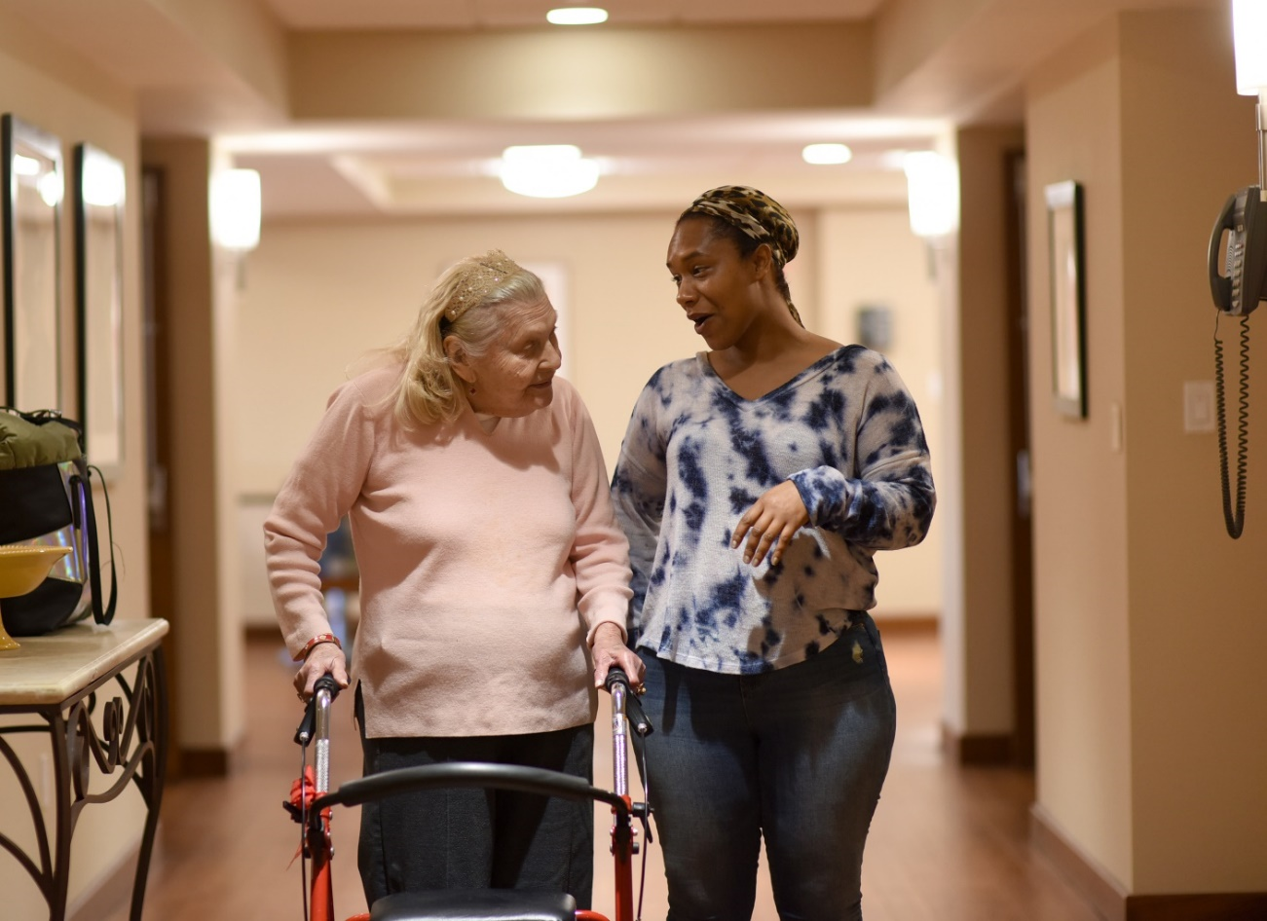
Asking What Matters in the hospital
Get to know person & what’s important
Inform care decisions

Slide 34
Getting to know person & what’s important: Commonly used & vetted questions
What is important to you today?
What makes life worth living? What does a good day look like?
What do we need to know about you to take better care of you?
What else would you like us to know about you?
http://www.ihi.org/Engage/Initiatives/Age-Friendly-Health-Systems/Documents/AgeFriendlyHealthSystems_How-to-Have-Conversations-with-Older-Adults-About-What-Matters.pdf

Slide 35
What Matters (hospital, ED, etc.): Inform decisions & care (patientprioritiescare.org)
Question | Rationale
“What concerns, worries you most when you think about being in the hospital.” | Letting individuals express their concerns and fears helps guide education and treatment
“What outcomes are you most hoping for from being in the hospital.” “What activity do you most want to be able to do as a result of being in the hospital.” | Identifies expectations and outcomes individual wants; focuses communication & care decisions

Slide 36
Tips for Acting on What Matters in hospital, ED, etc.
Put What Matters at top (notes, evaluations, consults, interdisciplinary huddles, etc.)
Use person’s priorities (not just diseases) in communicating, decision-making (link care options to patient’s goals)
“You said you wanted to get home by Saturday & be able to walk ½ block to your grandson’s game. I think (procedure; medication, PT, etc.) is the best way to help you do that.”

Slide 37
Assess mentation (Delirium) 2-item
Fick et al, J Hosp Med, 2015
1: Tell me the day of the week
Can check anywhere (white board, newspaper, etc.), but cannot ask
2: Please tell me the months of the year backward, December as first month
MISSED MONTH | If participant finished but missed one or more, it is incorrect; no prompting i
STUCK | Prompt only with: “what month comes before __________ (last month they said)?” Prompt up to two times; if after 2 prompts participant is frustrated, confused, or taking a long time, mark it incorrect and offer them an exit such as, “that’s a tough one, you’re doing well… let’s try the next question.”
WRONG ANSWER | If participant begins at November, starts forward, or begins spelling, re-read the instructions once. If the participant is incorrect again, mark it as incorrect but let them finish.
If incorrect on either question, use an additional screening tool to further assess, https://www.hospitalelderlifeprogram.org/request-access/delirium-instruments/
Remember to avoid correcting or helping the older adult; Inquiries to: Donna Fick dmf21@psu.edu.
(Please cite Fick et al, Journal of Hospital Medicine, 2015)
Not to be reproduced without permission. See disclaimer on back.

Slide 38

4M framework in practice (hospital): Delirium (mentation) & safe mobility
MD, nurse, aide, PT, SW, pharmacy coordinate delirium prevention (mentation) & (safe mobility)*
Early & frequent mobility (3x/day); PT if needed (tie mobility into What Matters)
Minimize at risk medications that worsens mentation or mobility (e.g. psychoactive, CNS)
Remove tethers quickly (e.g. IV, telemetry, catheters)
Minimize alarms
Promote sleep (avoid vital signs, nonessential care 10PM-6AM)
*Same interventions; also reduces risk of falls

Slide 39
4M framework in practice (ambulatory): Mr. A
Cardiologist: Heart failure & blood pressure (↑ β-blocker; add SGLT-2 inhibitor; defibrillator)
Endocrinologist: DM (start insulin, add oral agent)
Psychiatrist: Depression (↓ or stop β-blocker, add 2nd antidepressant); counselling
Primary Care: 15-20 minutes to do everything; BP & A1C metrics
Care coordinator: told to encourage adherence to medications he thinks causes his fatigue
Result for Mr. A: ~15 healthcare encounters/month; 12 medications → fatigue, weakness,↓ appetite; conflicting recommendations

Slide 40
4M framework in practice: ambulatory
Where to start?

Slide 41
Asking What Matters
Inform care decisions in ongoing care (e.g., ambulatory, home care)

Slide 42
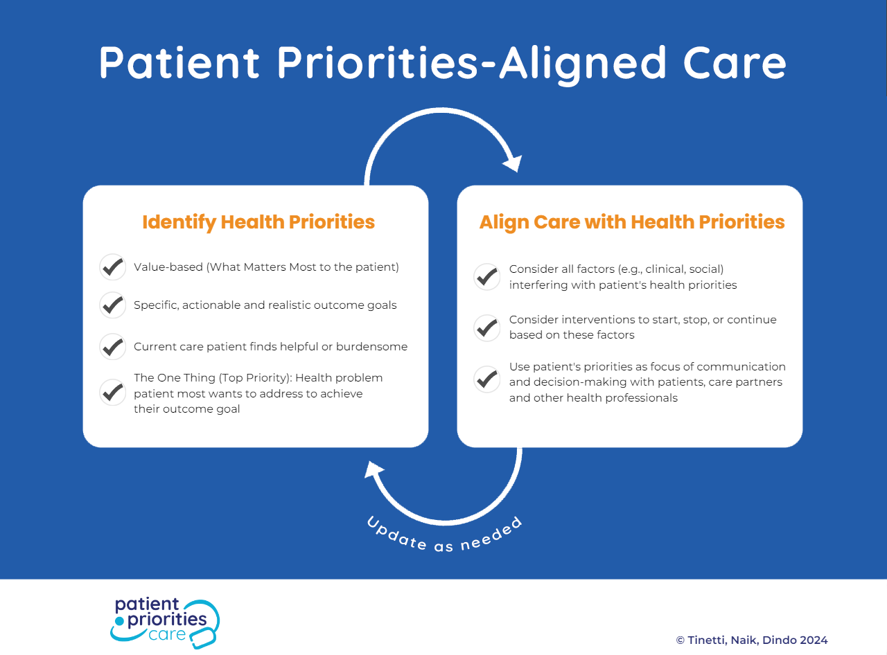

Slide 43
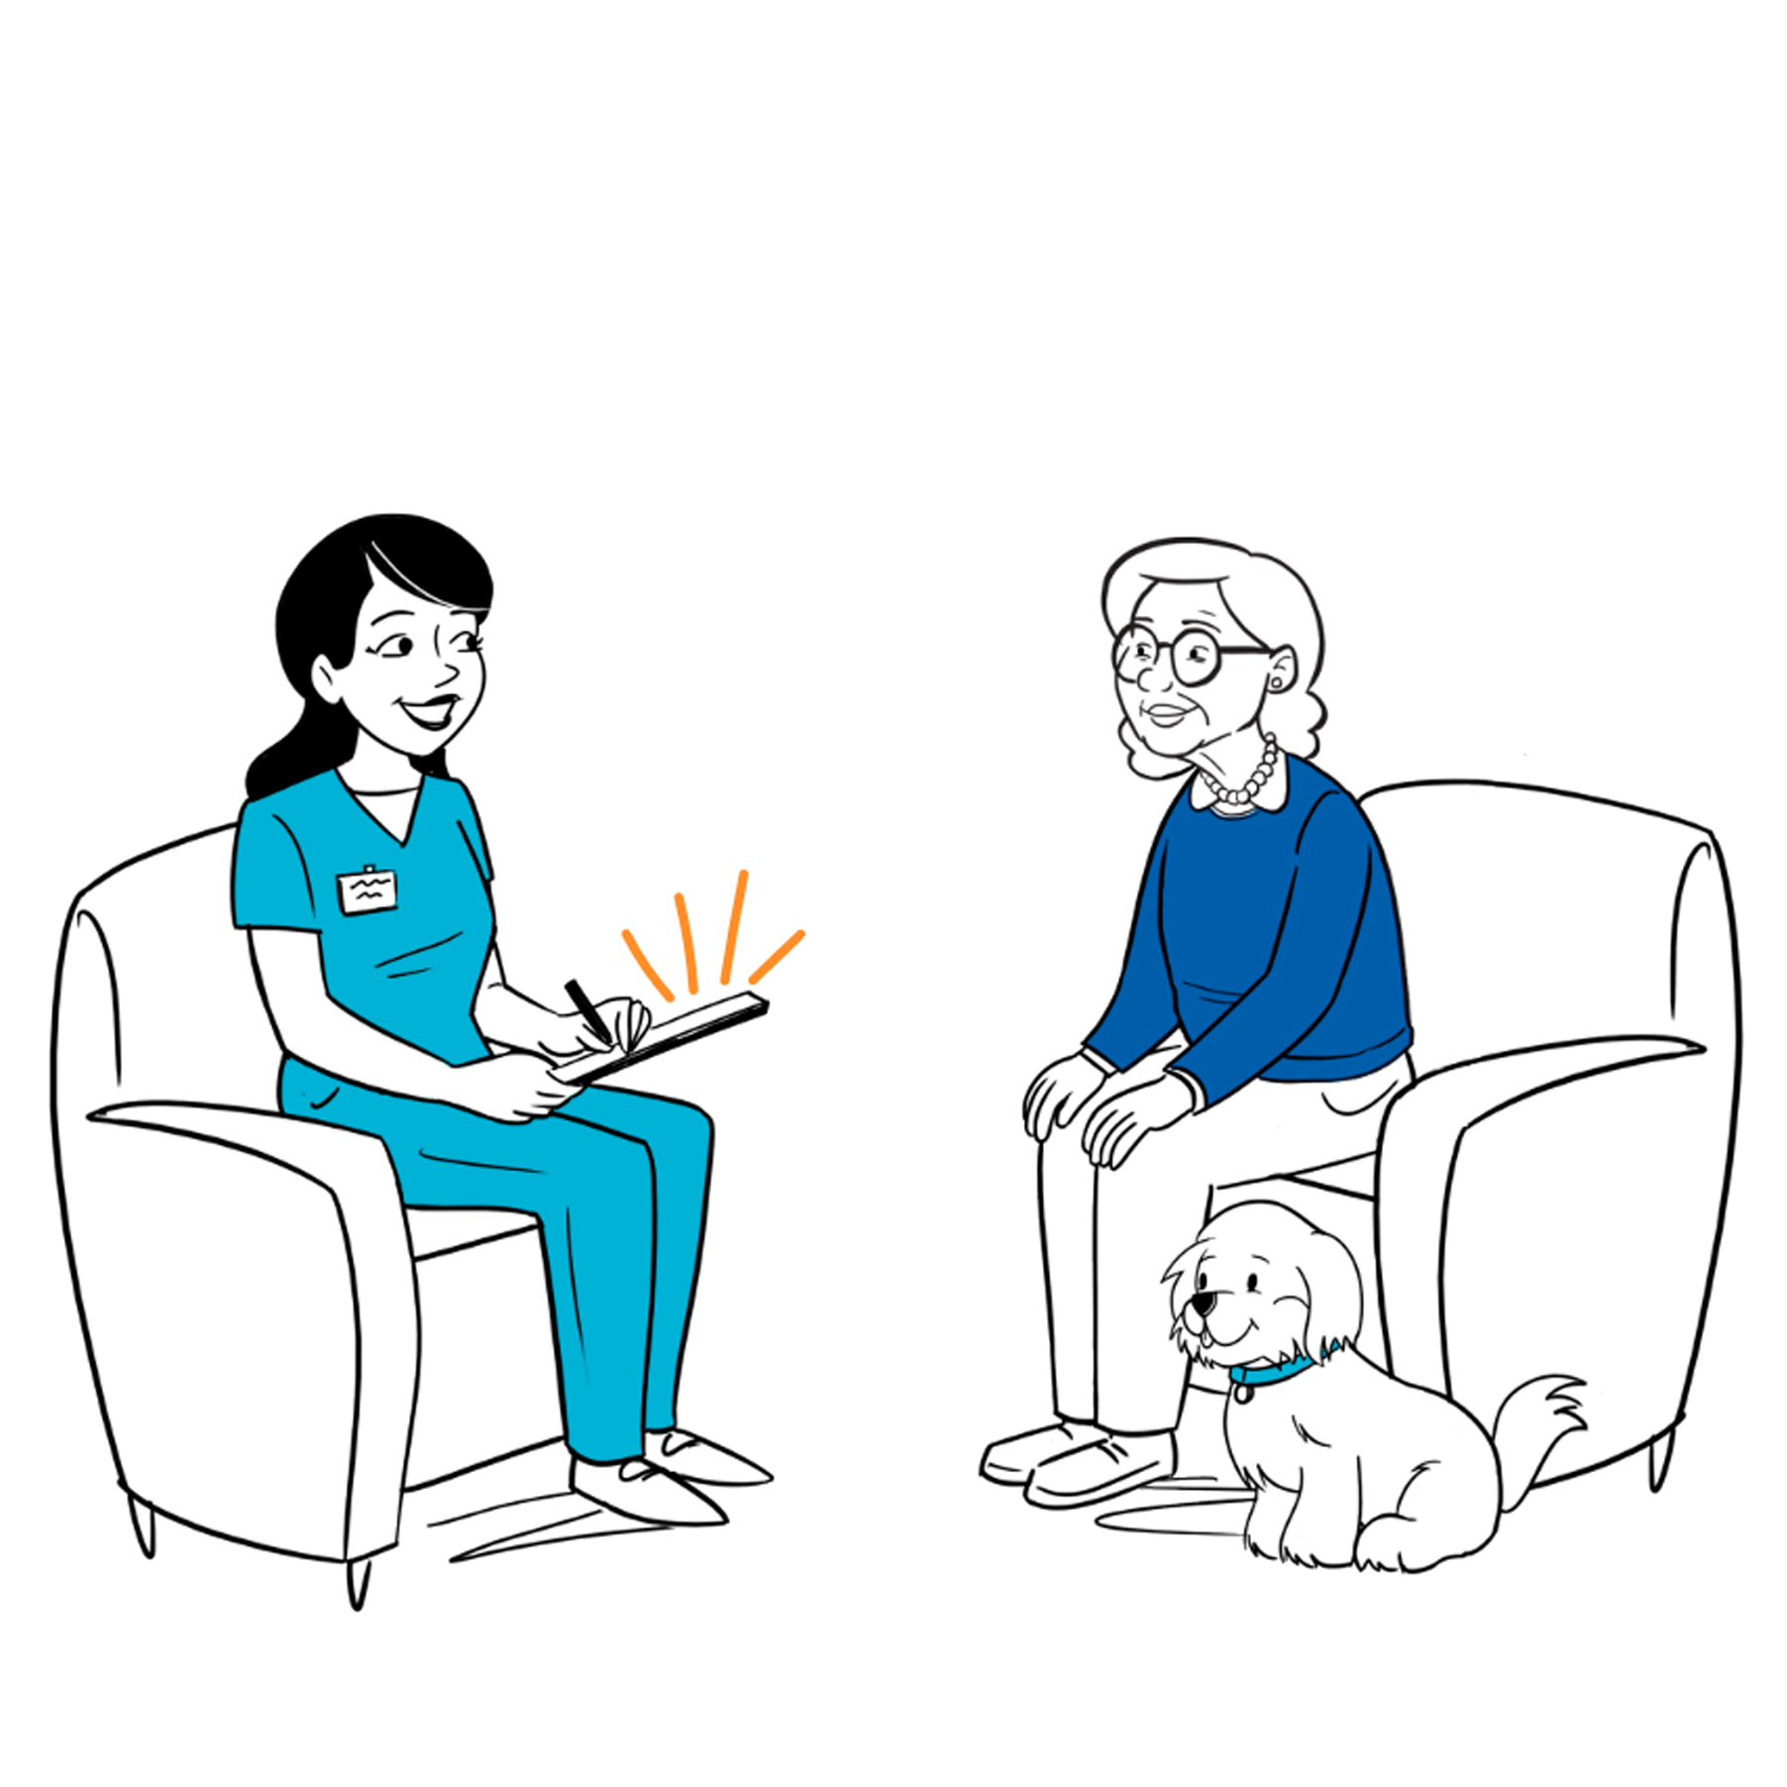


Identify Patients’ Health Priorities
Member of team meets with patient in-person, video, phone
OR
Self-directed (myhealthpriorities.org)
Health Priorities Template summary created and transmitted to health professionals

Slide 44
4 M based on What Matters to Mr. A: Health priorities (current care planning)
Completed myhealthpriorities.org with help of SW
Values: Connect with family and friends; Quality of life more important than longer survival
Outcome goals: walk block to play poker, babysit grandson weekly
Care preferences: Ok with glucose checks; avoid medications causing fatigue; likes clinicians but fewer visits; no procedures
One thing (Top priority): To be less tired so he can get to poker and babysit grandson weekly. Thinks it’s his medications
Tinetti, et al. JAMA Int Med., 2019

Slide 45
4M framework in practice (ambulatory): Mr. A
Each of Mr. A’s health professionals consider whether:
  “their condition(s) and medications” impedes or helps
    mentation (dementia, depression) or
    mobility (function) or
    achieve Mr. A’s goals (what Matters)
  their current or potential care, including medications affects mentation or mobility & consistent with Mr. A’s goals and preferences

Slide 46
4M framework in practice (ambulatory): Mr. A.
Each of Mr. A’s health professionals:
Consider starting, stopping, or continuing medications & other interventions depending on whether helps or hinders mentation & mobility & goal attainment
Use Mr. A’s goals and preferences in communication &
decision making
May need to help him modify goals based on mobility (function) & mentation

Slide 47
4Ms: Common target for all health professionals
PT/OT
Nurse
Dietitian
SW
Be less tired so he can
babysit grandson.
Thinks it’s his
medications
What Matters
PCP
Pharmacist
Care
Coordinator
specialist

Slide 48
4M care for Mr. A based on what matters to him: Primary care
Mentation
  MiniCog → negative
  PHQ9 positive → SW for counselling
Mobility screen (2 falls past 6 mos.; Timed up & go positive) → refer to PT
Medication fatigue, adverse effect on mobility which impedes What Matters
  Slow taper Ativan
  Refer to pharmacy for further recommendations

Slide 49
4M care for Mr. A based on what matters to him: Cardiology
Decrease beta-blocker (fatigue→ impede mobility & what matters)
Recommend cardiac resynchronization therapy ± ICD (help fatigue, mobility, function, help him do what matters)
Limit guideline-based medications to those that fit his priorities) → simplify → ↓burdensome, ↑adherence)

Slide 50
4M care for Mr. A based on what matters to him: PT & SW
PT: “I know you don’t like coming weekly and doing the exercises, but are you willing to try it for a month to see if it helps you walk better so you can get babysit?”
SW: “ We can do the talk sessions by telehealth. I think it might help your mood which may help your fatigue which you said was you biggest problem. You're also eligible for transportation services so you don’t have to take the 2 buses to your daughters which must be fatiguing”

Slide 51

Age Friendly 4M-Based Care: Getting started
Identify champion
Start with a few disciplines (e.g., primary care,1-2 specialties, Geriatrics, SW, PT pharmacy, nursing)
  Select population or setting to pilot (one unit or practice)
  Integrate into existing activity (e.g. interdisciplinary huddles)
  Try with one person

Slide 52
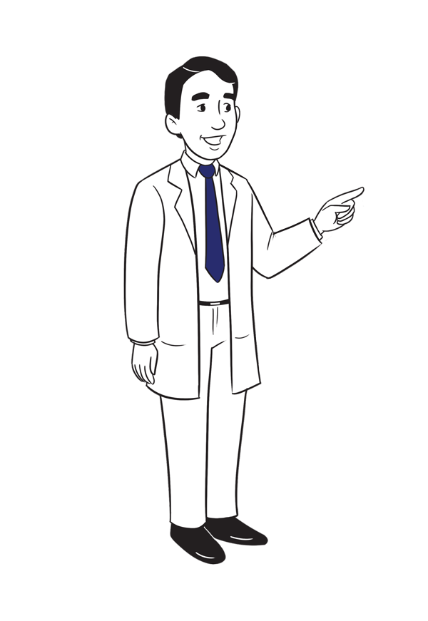
Align decisions with What Matters: Try with one person
Identify Health Priorities (facilitated or self-directed (MyHealthPriorities.org)
Go over priorities with patient, family
Link your agenda to patient's priorities
Try the steps:
  Consider what care is consistent (or not) with patient’s priorities
  Use priorities in discussing & choosing care
  Agree on 1 decision using the top priority (health problem most impeding goal)

Slide 53
More Information:
PatientPrioritiesCare.org
Self-Guided Priority Identification:
MyHealthPriorities.org
Implementation Resources:
patientprioritiescare.org/implementation-toolkit
Care Alignment Strategies:
decisionguide.patientprioritiescare.org/

